Slide 1






An Introduction
Getting ahead in the digital world
Spot and leverage trends
November 2017
Actionable Insights. Accurate Decisions
2009-2016

Slide 2
Agenda
1
An Introduction to LatentView
2
Smarter and faster insights using social data
3
Building a platform to leverage social data for Revlon

Slide 3
An Introduction to LatentView

Slide 4





LatentView at a glance
Founded in
Over
Growing at an average of over
2006
550
Work with
95+ %
20+
Princeton, San Jose, Chicago, Chennai, London, Singapore
People Strong
YoY over last 5 years
Fortune 500 Firms
Where we are featured..
2009-2016
>50% of new business through direct referrals
Average client relationship is 5 years
Repeat business at > 85%

Slide 5




















Who we work with

Slide 6
What we do
We empower customers in their digital transformation journey by helping them move up the analytics maturity curve through actionable insights that leads to data-driven decisions
MATH
ACTIONABLE
DATA
INSIGHTS
BUSINESS
TECHNOLOGY

Slide 7
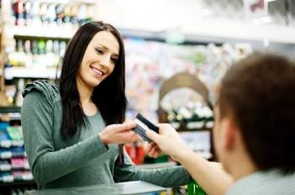


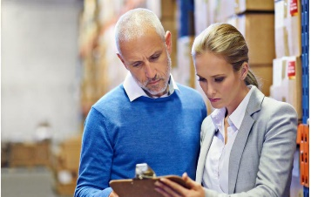








Wide Range of Analytics Services
Customer
Analytics
Marketing
Analytics
Finance/Risk
Supply Chain
Sales Analytics
Others
Micro
Segmentation
Campaign Design And Effectiveness
Retention / Churn Analysis
Demand Forecasting
Next Best Offer
Product Innovation
Customer Retention
Marketing Mix Optimization
Trust/ Counterfeit Analysis
Inventory Optimization
Channel Optimization
HR / Talent Analytics
Loyalty & Personalization
Brand And Competitive Positioning
Attribution Modeling
Sourcing And Replenishment
Cross-sell /
Up-sell
Web Analytics
Lifetime Value
Analysis
Customer Omni-channel Experience
Risk Forecasting
Supply Chain Metrics Visualization
Sales Metrics Visualization
Influencer Analytics

Slide 8




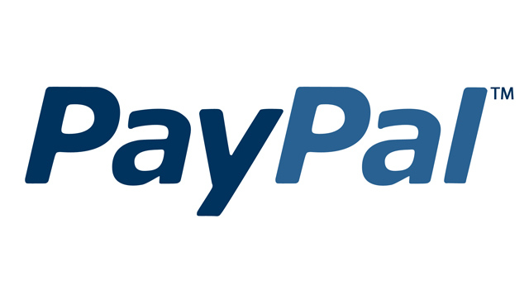

Our Customer Highlights
Builds Recommendation engine in Personalized marketing
Profiles Driver behavior to predict vehicle risks
A real-time platform that analyzes ecommerce transactions
Mines Amazon reviews for product feature innovation
Uses Center of excellence model for experimentation at scale
Analyzes Customer signals to manage retention risks

Slide 9
Smarter and Faster Insights

Slide 10
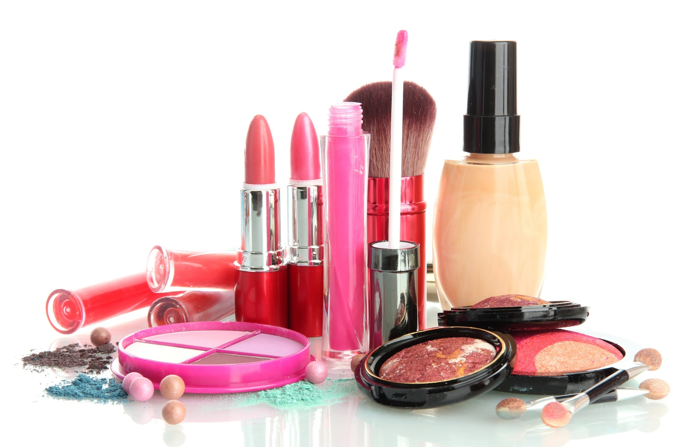
The digital consumer is very different
Independent beauty brands have achieved a growth rate of 15%, compared to industry average of 3.6% through impactful social presence and tapping into influencers
86% of the most-viewed beauty videos on YouTube were made by influencers, compared to 14% by beauty brands, themselves. Beauty video views have increased 65% year over year.
86% of women consumers use Social Media content as the chief source of online research before making a purchase
Sources:
http://www.klinegroup.com/blogs/index.php/2015/10/01/eye-on-indies-booming-beauty-brands-leading-industry-growth/,
https://www.ion.co/essential-stats-for-influencer-marketing-in-2017

Slide 11
Which gives brands opportunities to win
US based bakery chain reduced time to market by 2x, identified emerging trends early on increasing product overall sales and ticket sizes by using social analytics.
Insurance & Financial Investments firm identified top 20 influencers to be chosen as brand proponents. Brand proponents published product reviews for new products which helped in increasing brand awareness significantly.
Leading Snacks Manufacturer reduced innovation cycle time by 1.5x, identified 20 flavors at a fraction of ideation cost and gained a big first-mover advantage.
Leading CPG and Beverages Company improved on dollar share across key events through social analytics, with the highlight being a significant $ increase during a period of 8 weeks after Thanksgiving.

Slide 12



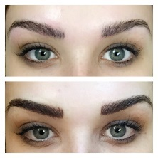


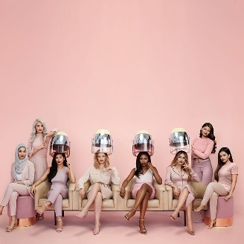
Beauty and fashion aren’t different – In a 3-day scan, we found
Trendspotting
Market Place
Brand Insights
Tinted Brow, usually a salon treatment, is gaining traction in the DIY space
Microblading is one of the biggest trends dominating the Salon space
Anastasia Beverly Hills, an independent beauty brand, is the most popular brand on Instagram with 14.3M followers
52% of eyebrow posts feature products by Anastasia Beverly Hills
L'Oréal started using influencer marketing with the introduction of the Beauty Squad in September 2016
Today it has become a team of 8 ethnically diverse influencers with on overall reach of 12M followers
Note: The analysis was done on a random sample of 2978 Instagram posts with the words “brow” or “eyebrow” in Feb 2017

Slide 13
Building a platform to leverage Social Analytics for Revlon

Slide 14
Social Analytics Platform
Trendspotting
Marketplace
Brand Insights
Translation Engine
Translation Engine
Non-English Language Support for 3 languages
Trend Analysis
Identify small competitors
Brand Benchmarking
Identify Influencers
Switchers Analysis
Brand Messaging
Events Analysis
Purchase Intent Analysis
Campaign Analysis
Interaction Engine – Uncovers interactions and influences, between Trends, Marketplace and Brand
Image Processing Engine – Object, feature, color, emotion recognition from images in Instagram, Twitter, etc.
Lexical Engine – Uses NLP and Machine Learning to convert unstructured text into structured topics and trends
Scraping Engine – Sources data from Twitter, Facebook, blogs, websites etc.

Slide 15
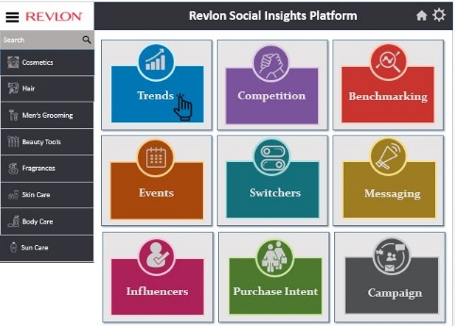





Process workflow
Text
Image
Refactor
&
Remodel
Meetings to understand
Strategy & Roadmap
Product Roadmap, Features
Competitors
Event Calendar
Data Extraction
&
Data Storage
Output Layer
(Classified text &
images)
Classification
(Lexical analysis, Google vision)
Requirements Gathering
Wireframe Design
Build
Deploy
1
2
3
4
Review & Signoff
Wireframe Signoff
Review & Retag
Validation & UAT
Product Managers
R & D
Tag validation
New Tags suggestion
New Keywords suggestion
Validating output trends
UAT – Dashboard output
Leadership
Sales & Marketing

Slide 16



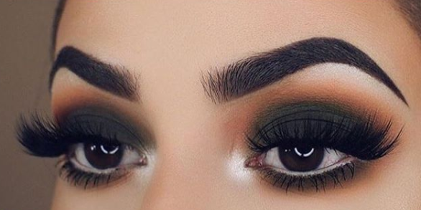
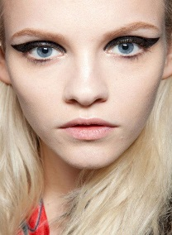
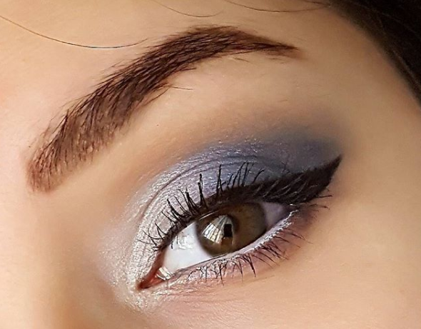
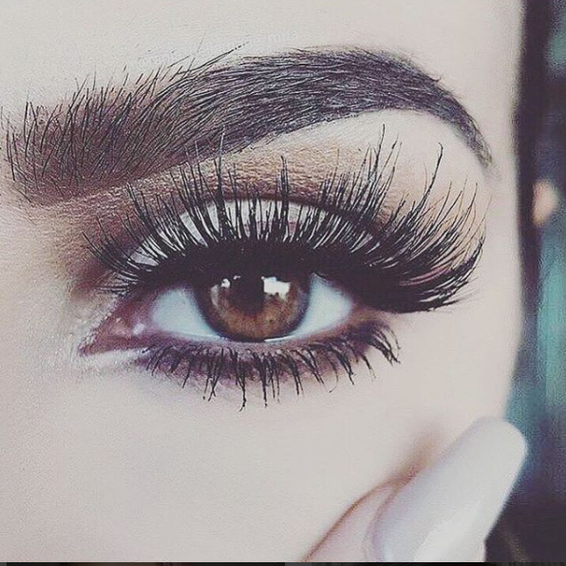


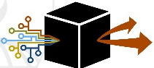
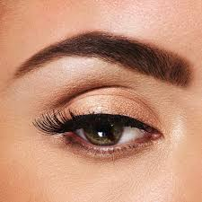
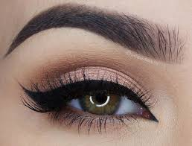
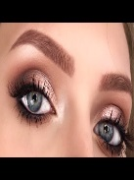

Image classification workflow
1. Image Extraction & Classification
2. Detect and classify images for validation
3. Review & Retag
Collect Images from Instagram and pass them on to the Classification API to detect & transform images using Neural Network
Using google vision API detect and classify the input layer to tags. Validate and retag images and use it as a feedback loop in the classification model
Revlon team to validate and retag sample images to improve model accuracy
Eyebrows Eyeshadow Teary eye Black Liner Mascara | Eyelashes Coloured lens Black Liner Mascara Rosy lips
Eyeshadow Black Liner Blue shadow Mascara Smokey eye | Eyebrow Coloured lens Teary eye Eyelashes Mascara
Eye Glitter Eye Paint Black Tinted Eyebrows Shimmery eyes | Blush Black eyelashes Wishbone winged eye liner Eyebrow micro blading
Glitter eye brows Black lashes Silver Smokey eye Shimmery eyes | Brown eyebrows Coloured Eyelash Black tear liner Mod Smokey eye
Google Cloud Vision API
6. Final Output
5. Test Data
4. Refactor & Remodel
Eye shadow 0.94
Black eye lash 0.85
Brown eyebrows 0.80
Coloured lens 0.75
Black tear liner 0.80
Mod Smokey eye 0.65
Based on the validations in step 2 refactor and remodel the classification system

Slide 17


Sample Image Extraction
Image Extraction
(using APIs from Instagram)
Processing
(Detect & Extract Features)
Image classification
Google storage
Continuous
Feedback loop
Label
Score
Eyes 0.96
Black Liner 0.86
Blue shadow 0.74
Mascara 0.5
Smokey eye 0.2
Images
Google cloud vision API
Vision JSON
Tag Validations
HTML
Label
Score
Validation
Eyes 0.96
Black Liner 0.86
Blue shadow 0.74
Mascara 0.5
Cluster Map
Smokey eye 0.2
Eyebrows
Eyelashes
Google compute engine
New Tags
Feature Identification and Feature Extraction

Slide 18
Sample Image Extraction
Processing
(Detect & Extract Features)
Image classification
Image Extraction
(using APIs from Instagram)
Image classification
Google storage
Continuous
Feedback loop
Label
Label
Score
Score
Eyes 0.96
Black Liner 0.86
Blue shadow 0.74
Mascara 0.5
Smokey eye 0.2
Images
Google cloud vision API
Vision JSON
Tag Validations
HTML
Label
Score
Validation
Re-engineer
&
Refactor
Eyes 0.96
Black Liner 0.86
Blue shadow 0.74
Mascara 0.5
Cluster Map
Smokey eye 0.2
Eyebrows
Eyelashes
Google compute engine
New Tags
Feature Identification and Feature Extraction

Slide 19
Wireframes

Slide 20

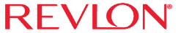













Revlon Social Insights Platform
Search
Trendspotting
Market Place
Brand Insights
Trends
Competition
Benchmarking
Events
Switchers
Messaging
Influencers
Purchase Intent
Campaign

Slide 21



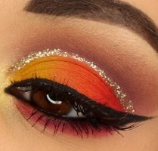
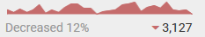
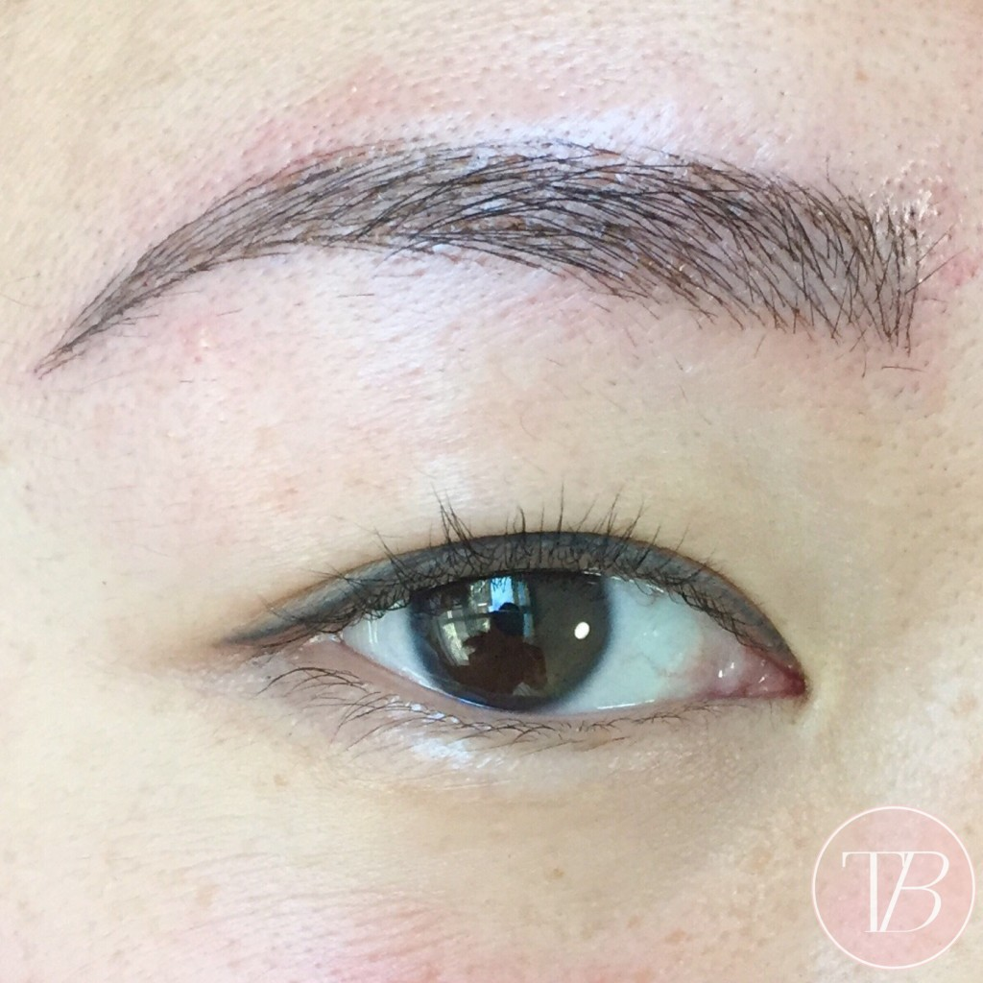



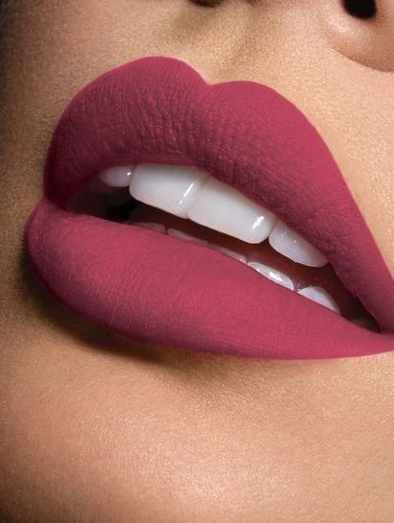

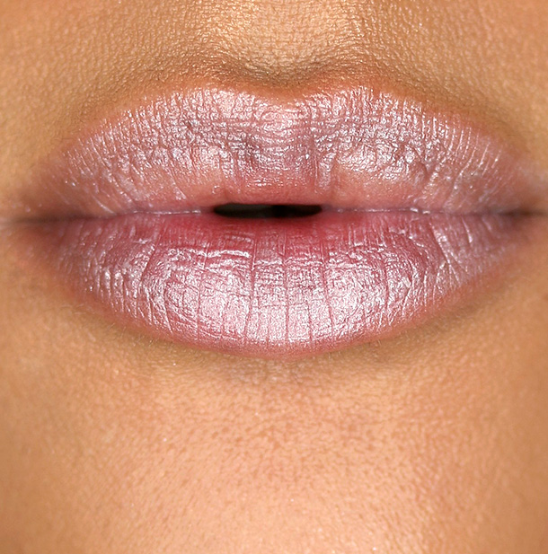
Revlon Social Insights Platform
Home > Trendspotting > Trends
October 29, 2017 – November 27,2017
Wishbone Winged Eyeliner
Sunset Eyes
Social Buzz – ALL
>
Total
EYES
2.1M
100K 5%
50K 3%
MicroBlading
Trend not yet named
1.1M
EYE BROW
>
200K 25%
30K 5%
0.7M
Shimmer Lips
Matte Lips
0.6M
>
LIPS
Index
34K 7%
100K – Current Volume
(5%) – MoM Change
65K 8%

Slide 22
Revlon Social Insights Platform
Home > Trendspotting > Trends
October 29, 2017 – November 27,2017
Wishbone Winged Eyeliner
Sunset Eyes
Social Buzz – ALL
>
Total
EYES
2.1M
100K 5%
50K 3%
MicroBlading
Trend not yet named
1.1M
EYE BROW
>
200K 25%
30K 5%
0.7M
Shimmer Lips
Matte Lips
Sample Conversations
Key Drivers
0.6M
>
LIPS
Index
34K 7%
100K – Current Volume
(5%) – MoM Change
65K 8%

Slide 23



Revlon Social Insights Platform
Home > Trendspotting > Trends
October 29, 2017 – November 27,2017
Wishbone Winged Eyeliner
Sunset Eyes
Social Buzz – ALL
>
Total
EYES
2.1M
100K 5%
50K 3%
Key Drivers of Trends - Microblading
MicroBlading
Trend not yet named
Driver
Total
1.1M
Full thick brows
124K
124K
124K
124K
EYE BROW
>
Long lasting brows
80K
20K
25K
35K
Sharpie doesn’t look
good
0.7M
200K 25%
30K 5%
65K
20K
20K
25K
Improved face
appearance
70K
15K
25K
30K
Shimmer Lips
Matte Lips
Social Buzz
Sample Conversations
0.6M
>
LIPS
Index
34K 7%
100K – Current Volume
(5%) – MoM Change
65K 8%

Slide 24
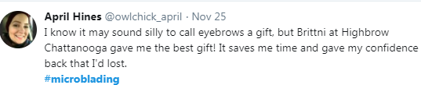
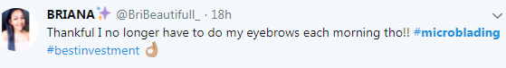
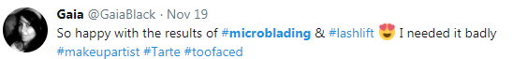
Revlon Social Insights Platform
Home > Trendspotting > Trends
October 29, 2017 – November 27,2017
Wishbone Winged Eyeliner
Sunset Eyes
Social Buzz – ALL
>
Total
EYES
2.1M
100K 5%
50K 3%
Sample Conversations - Microblading
MicroBlading
Trend not yet named
1.1M
EYE BROW
>
200K 25%
30K 5%
0.7M
Shimmer Lips
Matte Lips
Key Drivers
Social Buzz
0.6M
>
LIPS
Index
34K 7%
100K – Current Volume
(5%) – MoM Change
65K 8%

Slide 25



Revlon Social Insights Platform
Home > Trendspotting > Trends > Comparison
Trend 1 - MicroBlading
Trend 2 – Sunset Eyes
Social Buzz – ALL
Wishbone Winged Eyeliner
Sunset Eyes
Total
2.1M
<
100K 5%
50K 3%
1.1M
Wishbone Winged Eyeliner
0.7M
0.6M
Index
100K – Current Volume
(5%) – MoM Change

Slide 26
Thank You!
Do You Have Any Questions?
www.LatentView.com
| Princeton | San Jose | Seattle | London |
Chennai | Singapore |
Email: Shalabh@latentview.com

